Slide 1


Visualizing Carbon Footprints Across Sectors Using Power BI

Slide 2

Learning Objectives
• Understand carbon emissions and their impact sector-wise
• Learn to build interactive visualizations using Power BI
GOAL
• Gain experience in data cleaning, modeling, and DAX functions
• Analyze trends and patterns across industries to promote sustainability
Source :
www.freepik.com/

Slide 3
Tools and Technology used
Power BI (Main Visualization Tool)
Used to build interactive dashboards that display carbon emissions across sectors and countries from 2019– 2023. Visuals like tables, bar charts, and filters helped uncover trends and patterns.
DAX (Custom Calculations) DAX formulas helped compute total emissions, sector-wise contributions, and global rankings—turning raw numbers into meaningful insights.
Excel / CSV Files (Data Source) Raw data was stored in Excel or CSV formats. These were cleaned and structured to prepare a solid base dataset for analysis.
Open Data Sources Emission data was gathered from credible sources like Our World in Data and the IEA to ensure accuracy and relevance.
Power Query Editor Used within Power BI for data cleaning—removing duplicates, formatting fields, and shaping the dataset for analysis.

Slide 4
Methodology
Collected or simulated carbon emission data sector-wise
Cleaned and transformed data in Power BI
Created calculated columns for % share, year-on-year change
Built visuals like bar charts, pie charts, and slicers for filtering
Highlighted insights and emission-heavy sectors

Slide 5
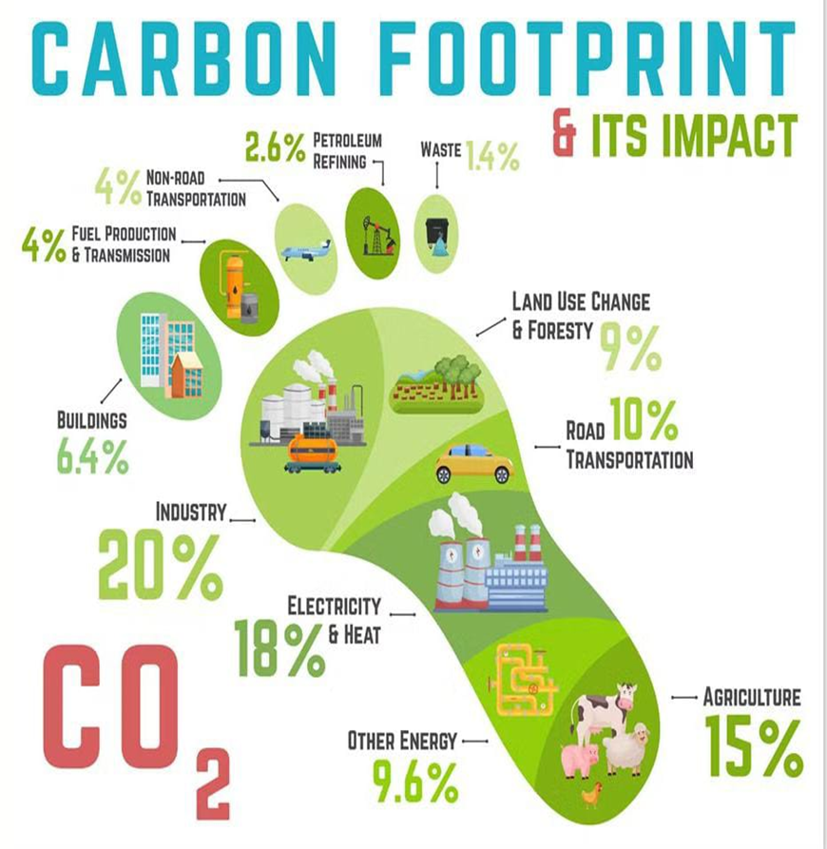
Problem Statement:
Climate change stands as one of the most pressing global threats of our time. Yet, there remains a significant gap in public awareness and stakeholder understanding regarding which sectors are the key contributors to carbon emissions. Without clear, accessible, and data-driven insights, it becomes challenging to drive meaningful action. There is a critical need for intuitive visual tools that can translate complex emission data into actionable knowledge for decision-makers, communities, and individuals alike.

Slide 6
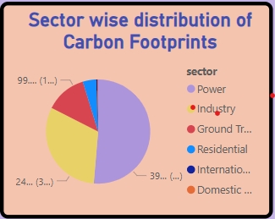
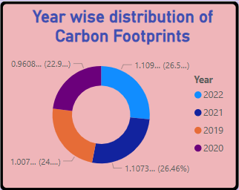
Solution:
Making carbon footprints visible—one sector at a time, for a cleaner and more informed tomorrow…
📊 Explore sector-wise and time-based carbon emissions, enabling a clear understanding of how different industries — such as energy, transport, and agriculture — contribute to global CO₂ levels.

Slide 7
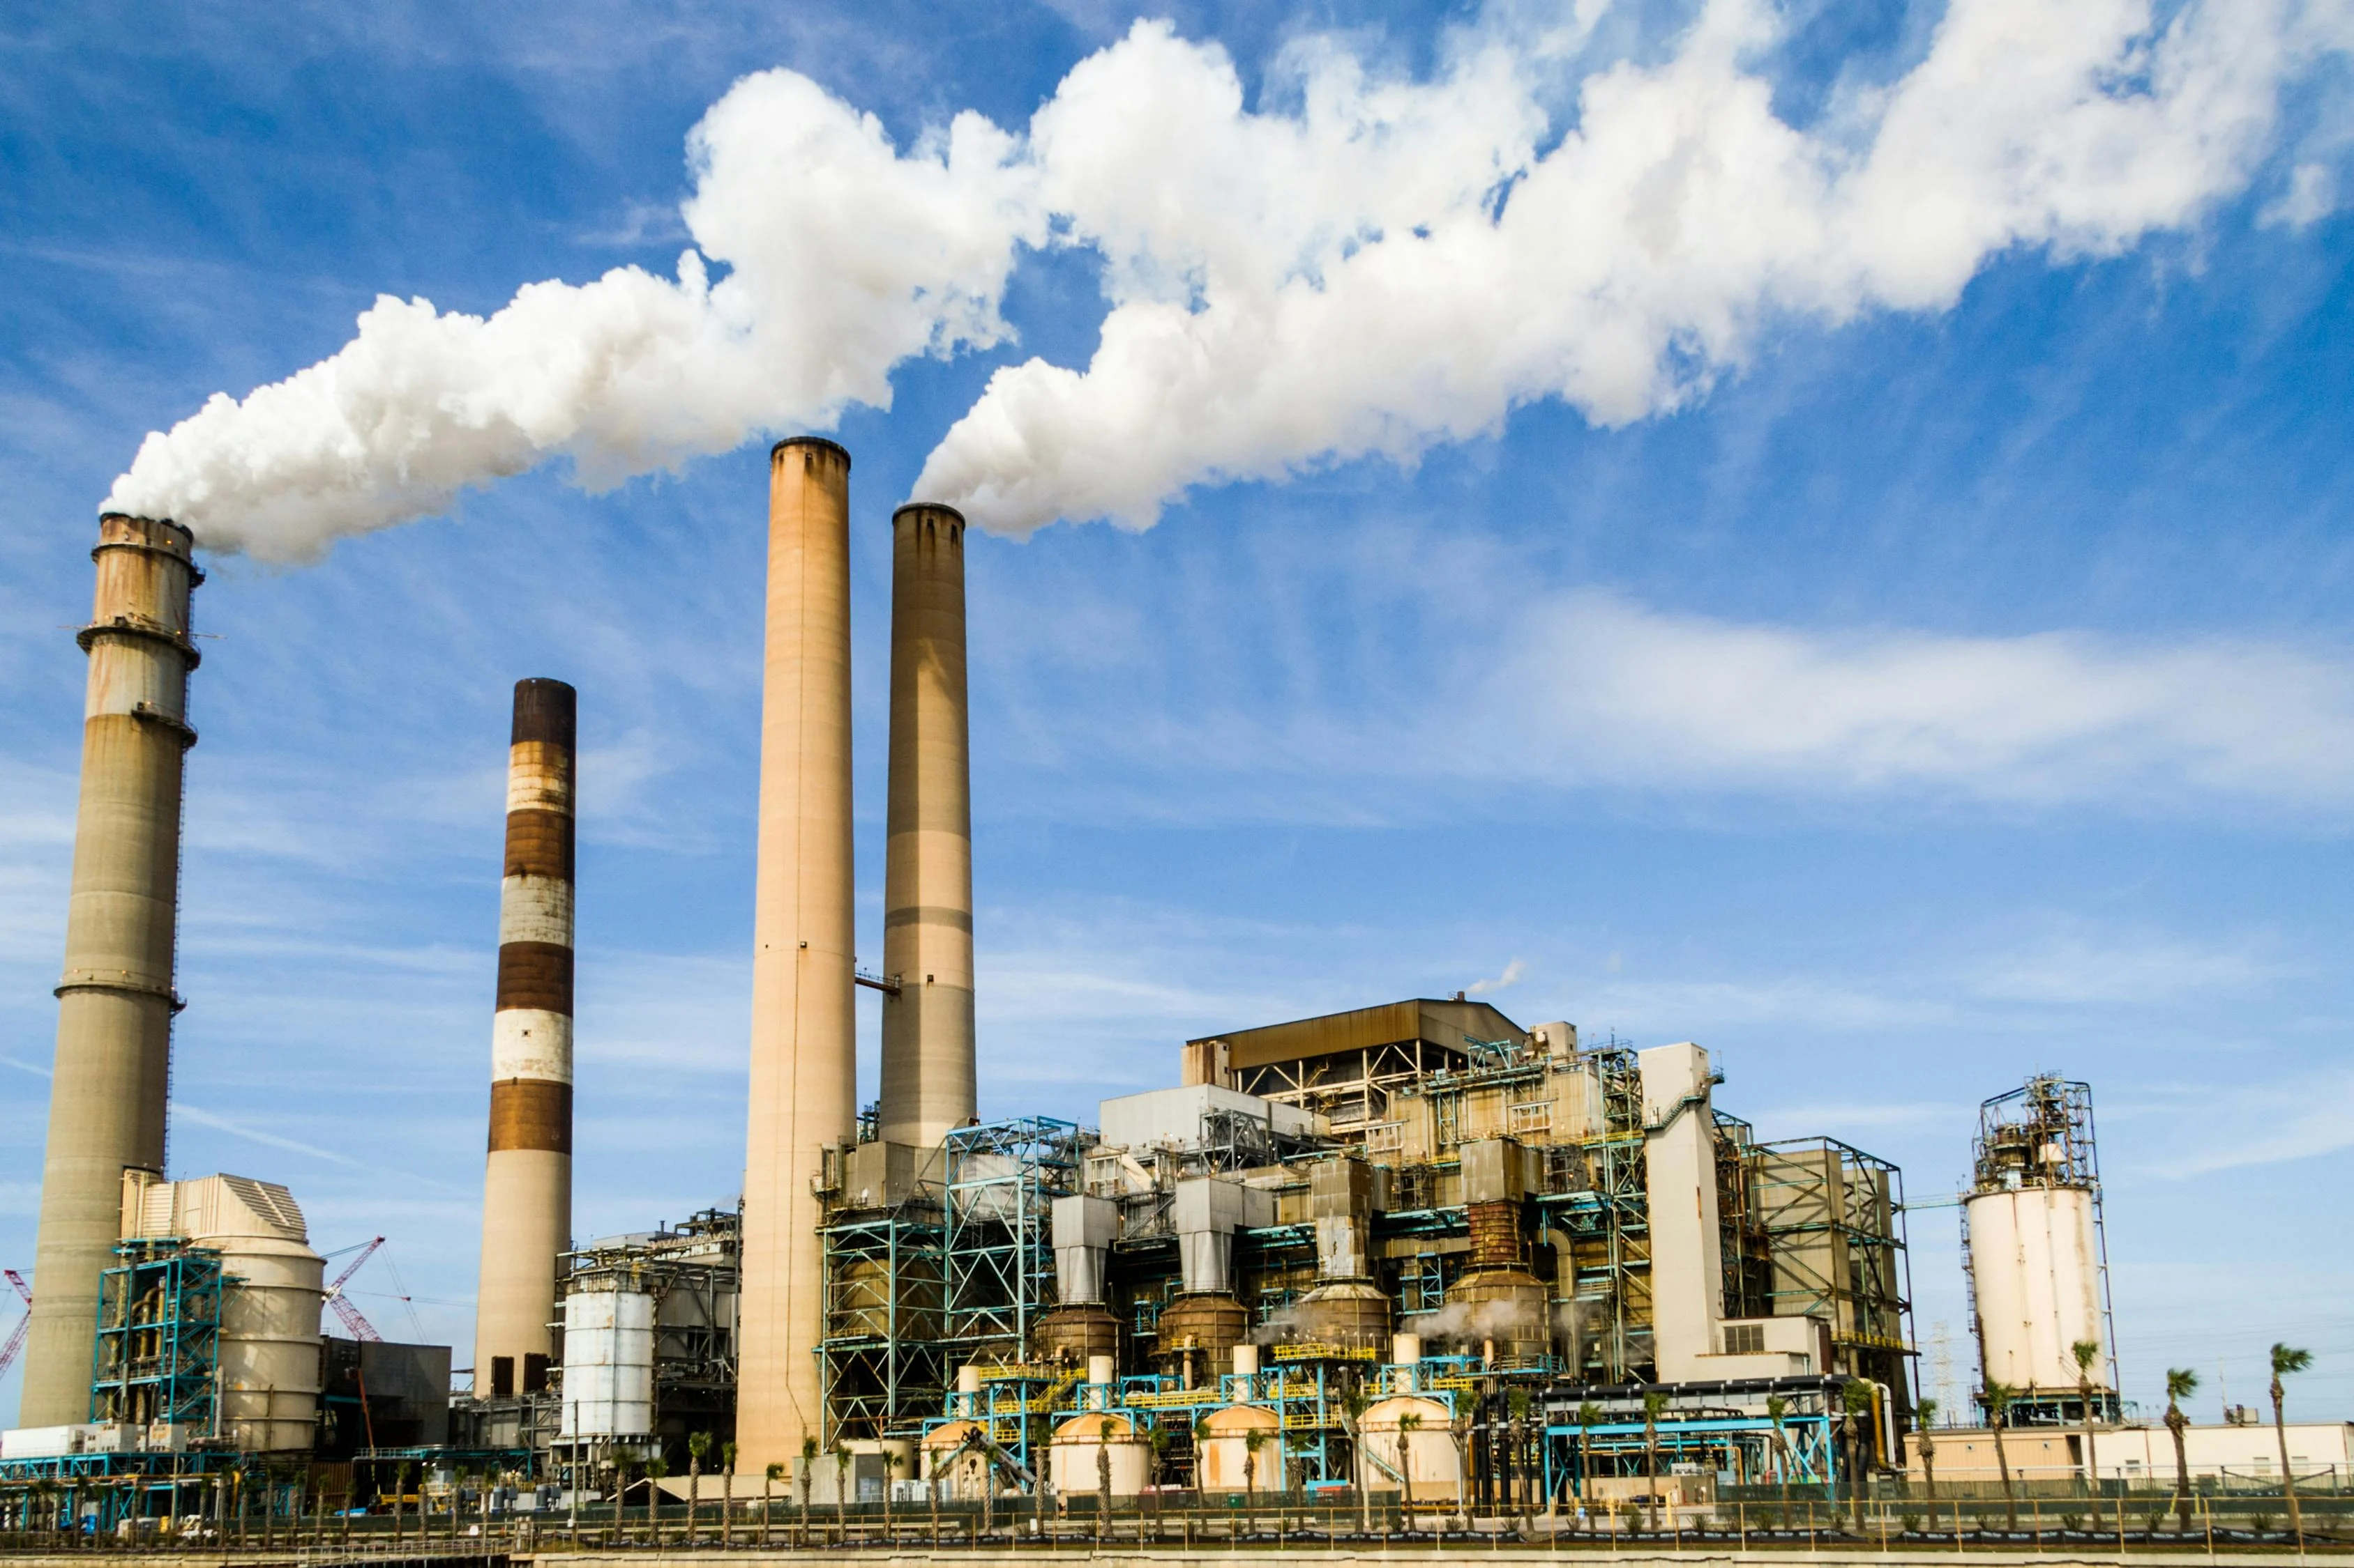
🔍 Identify the highest-emitting sectors and countries, providing visibility into key areas responsible for the majority of greenhouse gas emissions. For example, the energy and transport sectors account for over 50% of global CO₂ emissions.
2.

Slide 8
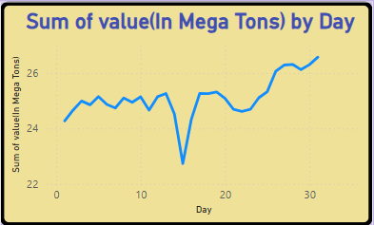
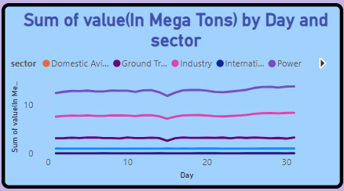
3.
⏳ Track changes in carbon footprints from 2019 to 2023, highlighting trends and fluctuations that can inform sustainable policy decisions and behavior change.

Slide 9

4.
Drill down using filters by sector, region, and year to allow tailored analysis for governments, NGOs, researchers, and the general public.

Slide 10
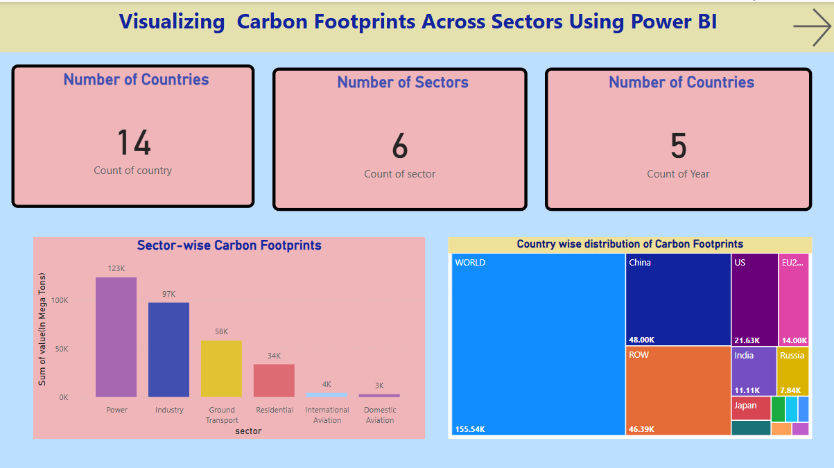
Screenshot of Output:
Dashboard Insights Summary
The analysis covers 14 countries, 6 sectors, and a 5-year period.
The Power sector stands out as the largest carbon emitter, contributing 123K Mega Tons.
Industry and Ground Transport follow, with 97K and 58K Mega Tons respectively.
On a country level, China leads in emissions (48K Mega Tons), followed by the Rest of World and the United States.
A small group of sectors and countries are responsible for the majority of emissions—highlighting where impactful change is most needed.
The dashboard offers a clear, data-driven foundation to support sustainability strategies and informed policy decisions.

Slide 11
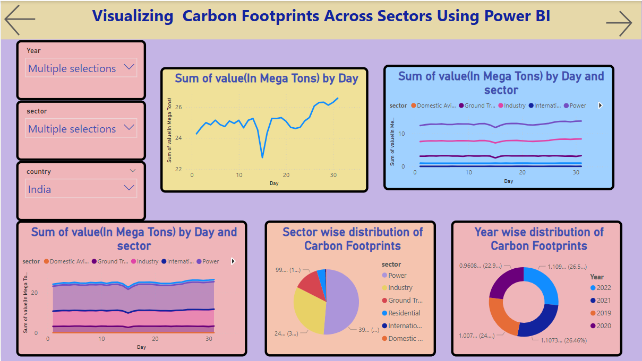
Focused Insights
Daily carbon emissions in India show a gradual upward trend, highlighting increasing activity over time.
The Power and Industry sectors remain the most consistent and dominant contributors to emissions.
Ground Transport plays a notable secondary role, while emissions from aviation sectors are minimal but present.
Emissions are evenly distributed across the years, suggesting no major annual spikes or drops.
The dashboard’s interactive filters enable detailed exploration by year, sector, and country—supporting informed decision-making.

Slide 12
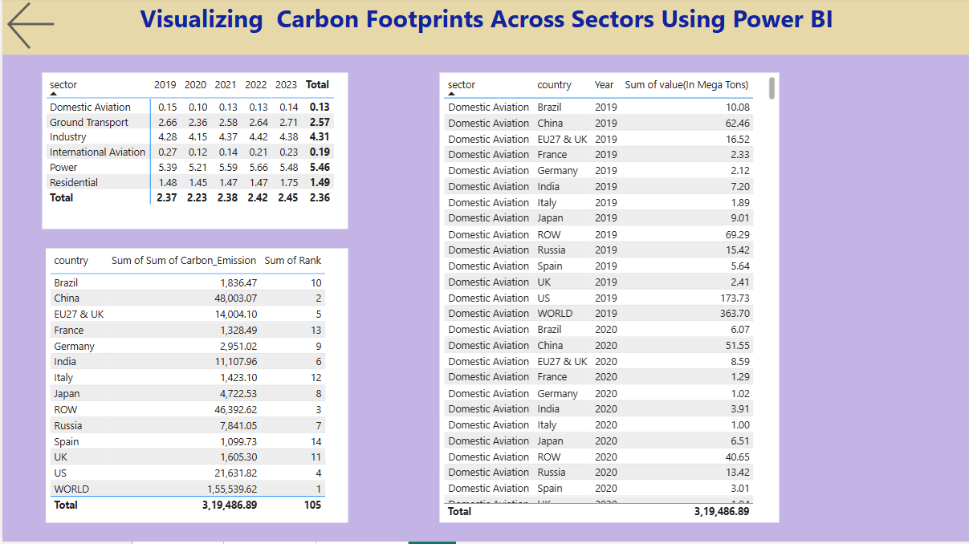
Key Insights
China remains the top emitter, followed by the US, EU, and India, as shown in the country-wise distribution.
Power and Industry continue to dominate in terms of sectoral carbon output globally.
The overall trend shows a gradual rise in emissions, indicating increased activity or reduced mitigation.
The visual breakdown helps pinpoint major contributors by both region and sector, supporting targeted sustainability strategies.
Interactive navigation and filters enhance user experience and make analysis flexible.

Slide 13
Conclusion:
The dashboard effectively empowers users, policymakers, and organizations to take data-driven actions toward reducing carbon footprints.
It identifies critical areas where improvements can be made, promoting targeted efforts for sustainability.
By raising awareness and encouraging informed decision-making, the dashboard drives proactive steps toward environmental preservation.
Power BI’s dynamic and scalable visualizations ensure that the platform remains adaptable to evolving needs, delivering long-term value.
This solution not only facilitates a deeper understanding of carbon emissions but also plays a pivotal role in advancing global sustainability initiatives.

Slide 14
THANK YOU

